Slide 1

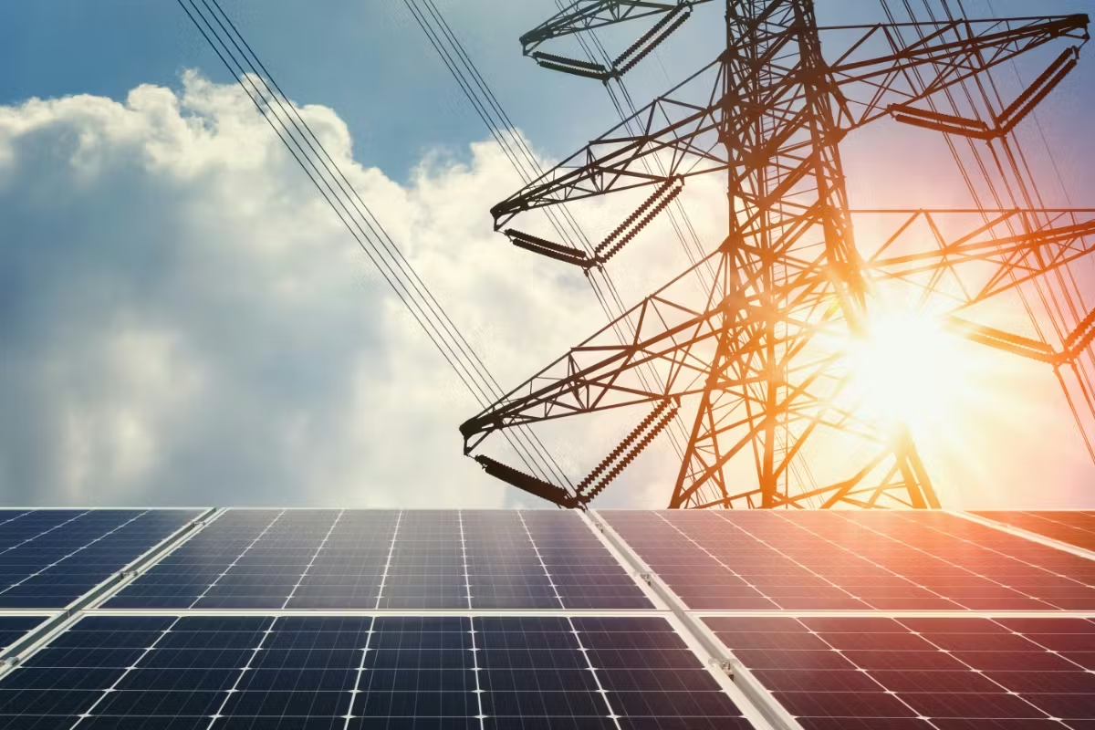



Session 5.2: Off-Site Solutions Deep Dive
Vietnam’s DPPA
Pricing Considerations

Slide 2

About the Speaker
Cong Nguyen
Allotrope Partners
Vietnam Clean Energy Manager
Cong is a renewable energy professional with over a decade of experience. Prior to joining Allotrope, Cong cultivated extensive clean energy technical expertise by supporting the development of solar and wind farms, battery energy storage systems, and asset management projects. In his role with Allotrope, Cong supports corporate clients to evaluate and implement clean energy and decarbonization solutions across a range of technologies. This includes leading techno-economic assessments to determine costs and benefits for specific sites, managing projects and building stakeholder relationships, and supporting business development efforts in Vietnam. Cong holds a Bachelor’s degree in Electromechanics Maintenance Engineering from Hung Yen University of Technology and Education and has advanced certifications in renewable energy and reliability engineering.

Slide 3
Session Roadmap
Follow the Money: From your EVN Bill to a Bankable DPPA
# | Module
1 | The Baseline: What You Pay EVN Today
2 | Virtual DPPA Money Flow: The Five-Line Bill
3 | CfD Mechanics: What Drives Your Quoted Price
4 | Developer Economics and the Three Gates
5 | Case Studies 5 & 6
6 | Key Decision Points and Wrap-up
By the end of this session you will be able:
1. Breakdown a virtual DPPA monthly settlement into its five components and compare it to your EVN bill
2. Explain how the CfD strike, market price (FMP), loss factors, and grid fees set your net cost
3. See why buyers, sellers and lenders each have a “gate” and why a deal must pass all three
4. Leave with realistic pricing expectations grounded in a real factory model
Scope: Virtual DPPA (grid CfD) only.

Slide 4
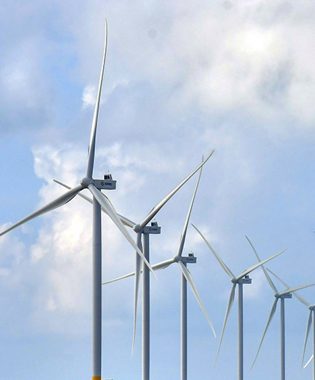
Module 1:
The Baseline: What You Pay EVN Today

Slide 5
Module 1 - The Baseline
What You Pay EVN Today: TOU Is The Reference Price
Period | Hours | Versus Base
Off-peak | 00:00 - 06:00 | ~0.52x
Normal | 06:00 - 18:00 | 1.0x
Peak | 18:00 - 23:00 | ~1.78x
Why this matters for DPPA
Every DPPA offer is judged against this bill: “business-as-usual” (BAU)
Peak hours cost 3.4x off-peak: your load shape decides what "average" means for you
Residual energy (load not covered by the DPPA) keeps paying these TOU rates
Sunday rule: no peak period on Sundays (all hours normal).
Voltage | Off-peak | Normal | Peak
>=110kV | 0.034 | 0.065 | 0.116
22-110kV | 0.037 | 0.070 | 0.126
6-22kV | 0.042 | 0.079 | 0.141
<6kV | 0.049 | 0.092 | 0.164
The savings benchmark
BAU = your current EVN bill escalated ~4%/yr (historical trend 2015-2024)
A DPPA is evaluated on cumulative cost vs BAU over 10 years and over the project lifetime - not just Year 1
EVN tariff escalation is the main source of long-term DPPA value
(USD/kWh approx. 2025)

Slide 6
Module 2:
Virtual DPPA Money Flow: The Five-Line Bill

Slide 7
Module 2 - The Five-Line Bill
Virtual DPPA Money Flow: Three Relationships, One Bill
VWEM SPOT MARKET
pays generator FMP
per kWh generated
energy -> market (FMP)
RE GENERATOR
sells 100% of output
to the spot market
YOUR FACTORY
pays EVN the DPPA bill;
settles CfD with generator
CfD settlement (two-way)
EVN
meters, wheels, & bills
the DPPA customer
DPPA bill (5 lines)
Physical electrons flow through the national grid as usual and the DPPA is a financial overlay
The generator's revenue = spot sales at FMP + CfD settlement with your factory
Your factory cost = the five-line EVN bill + the CfD settlement

Slide 8
Module 2 - The Five-Line Bill
Virtual DPPA Money Flow: Three Relationships, One Bill
VWEM SPOT MARKET
pays generator FMP
per kWh generated
energy -> market (FMP)
RE GENERATOR
sells 100% of output
to the spot market
YOUR FACTORY
pays EVN the DPPA bill;
settles CfD with generator
Pays FMP per kWh
CfD settlement (two-way)
EVN
meters, wheels, & bills
the DPPA customer
DPPA bill (5 lines)
Electricity Flows
Electricity Flows
Physical electrons flow through the national grid as usual and the DPPA is a financial overlay
The generator's revenue = spot sales at FMP + CfD settlement with your factory
Your factory cost = the five-line EVN bill + the CfD settlement
CFD
Electricity Flows
Financial Flows

Slide 9
Module 2 - The Five-Line Bill
The Monthly DPPA Settlement Has Five Lines
# | Line | Formula | Level (2025 reference)
1 | Market energy | Q_Khc x FMP x k x K_pp | FMP avg ~1,426.6 VND/kWh; k~1.026; K_pp by voltage
2 | DPPA service fee | Q_Khc x C_dppa_dv | 360 VND/kWh
3 | Balancing fee | Q_Khc x P_cl | 163.3 VND/kWh
4 | Residual purchase | (Load - Q_Khc) x EVN retail | TOU rates
5 | CfD settlement | (Strike - FMP) x min(Q_c, Q_Khc) | Two-way: can be + or -
Lines 1-4 are billed by EVN. Line 5 settles bilaterally with the generator under CfD contract.
Q_Khc = the renewable volume actually received and consumed (defined next slide).
CFMP = FMP x k: k converts the market price to the customer delivery point (price conversion, not a volume loss).

Slide 10
Module 2 - The Five-Line Bill
Contracted Volumes & Actual Electricity Consumption
Which volume? You settle only on what you actually consume
Q_adj = Q_meter / K_pp delivered volume at your meter
Q_Khc = min(Load, Q_adj) settled volume (lines 1-3)
Q_CfD = min(Q_c, Q_Khc) CfD settles on received volume
Grid losses are reflected through coordinated volume and price conversions: K_pp converts generator-meter output into buyer-side credited volume, while k and K_pp convert FMP into the corresponding buyer-side market-energy price.
If the plant generates more than you consume in an hour, the excess earns the generator spot revenue only; it is NOT billed to you and does NOT earn CfD
Practical consequence: Contracted volume (Q_c) above your real consumption buys nothing

Slide 11
Module 2 - The Five-Line Bill
Simulation: Industrial Park Buys 6,000 MWh/month
Parameter | Symbol | Value
Consumption = received RE volume | Q_KH = Q_Khc | 6,000,000 kWh/mo
Contracted CfD volume | Q_c | 6,000,000 kWh/mo
CfD strike price | P_c | 1,300 VND/kWh
Market price (monthly avg) | FMP | 1,200 VND/kWh
Price conversion factor | k | 1.026
Loss factor (110 kV) | K_pp | 1.008
DPPA service fee | C_dppa_dv | 360 VND/kWh
Balancing fee | P_cl | 163.3 VND/kWh
Avg retail price (residual) | P1 | 2,204 VND/kWh
Scenario
A 50 MW solar plant contracts its full output to one industrial customer
Consumption exactly equals delivered RE volume - no residual EVN purchase this month
Strike just 100 VND above market - watch what the fees do
Source: EAVCED public training

Slide 12
Module 2 - The Five-Line Bill
The Five Lines, Computed
Line | Calculation | VND/month
1. Market energy (C_DN) | 6,000,000 x 1,200 x 1.026 x 1.008 | 7,446,297,600
2. Service fee (C_dppa) | 6,000,000 x 360 | 2,160,000,000
3. Balancing fee (C_cl) | 6,000,000 x 163.3 | 979,800,000
4. Residual (C_bl) | 0 kWh x 2,204 | 0
EVN bill (C_EVN) | lines 1 + 2 + 3 + 4 | 10,586,097,600
5. CfD settlement (C_CfD) | (1,300 - 1,200) x 6,000,000 | 600,000,000
TOTAL (C_KH) | C_EVN + C_CfD | 11,186,097,600
Effective cost = 11,186,097,600 / 6,000,000 = ~1,864 VND/kWh for fully renewable supply (versus ~2,204 VND avg retail in the example)
Generator side: 6,048,000 kWh x 1,200 (spot) + 600,000,000 (CfD) = 7,857,600,000 VND

Slide 13
Module 2 - The Five-Line Bill
Your Monthly Settlement Has Five Lines
Component (per matched kWh) | VND/kWh | USD/kWh (cents)
Market energy at 2025 avg FMP x k x K_pp (22-110kV) | ~1,504 | ~6.0
DPPA service fee (C_dppa_dv) | 360 | 1.4
Balancing fee (P_cl) | 163.3 | 0.7
Delivered cost before CfD | ~2,027 | ~8.1
The 523 VND/kWh of fixed fees applies to every matched kWh, regardless of your strike
They are set by regulation, not negotiation
Compare ~2,027 VND delivered (pre-CfD) with your own TOU mix - for many factories that is already near or above average grid cost
Virtual DPPA is rarely a Day-1 discount. Its value comes from price certainty versus EVN escalation, being able to cover 100% of annual electricity demand with contracted renewable generation, and utilizing credible renewable claims.

Slide 14
Module 3:
CfD Mechanics: What Drives Your Quoted Price

Slide 15
Module 3 - CfD Mechanics
The CfD Is Two-Way: Certainty, Not Automatic Savings
CfD cash flow = (Strike - FMP) x Q_CfD
Net effect: the renewable energy cost is locked near the strike (+ fees), whatever the market does
2025 reference: FMP averaged ~1,427 VND/kWh with strong hourly volatility; the CfD removes that volatility from the budget
A strike below expected average FMP would mean expected receipts, but no developer can finance that (Module 4)
Market condition | Who pays whom
FMP below strike | You top up the generator
FMP above strike | Generator pays you back

Slide 16
Module 3 - CfD Mechanics
Strike Escalation & The Year 1 Reality
Strike escalation (e.g., 4%/yr)
What Year 1 usually looks like
Escalating strikes improve the seller's and lender's lifetime economics...
...but do nothing for the Year 1 cost and compound against BUYER later
Negotiate the escalation index as hard as the starting strike (fixed VND vs CPI vs USD-linked)
In most realistic structures, Year 1 DPPA cost is at or above BAU
Savings build as EVN tariffs escalate (~4%/yr) against BUYER locked strike
→ Advice: Evaluate on 10-year and lifetime cumulative cost, not on Year 1 alone
Internal Budget Question to Consider: Can we accept a modest Year 1 premium to cap 15~25 year exposure?

Slide 17
Module 3 - CfD Mechanics
Contract Volume VS Your Load Shape
Solar generation peaks midday, but the factory runs its own shape. The overlap—hour by hour - is what matters most.
If you... | Then… | Cost consequence
Over-contract (Q_c > consumption) | CfD caps at consumed volume - excess earns nothing | You paid contract terms for volume you can’t settle
Match contract to hourly overlap | Every contracted kWh settles | Efficient; this is the target
Under-contract (Q_c < overlap) | More residual purchased from EVN at TOU | Less price certainty, smaller renewable claim
Ask every developer for an hourly (8760 hour) matching analysis against your meter data, not an annual percentage
Batteries can shift the overlap window but add CAPEX the tariff must carry (see the case study)

Slide 18
Module 4:
Developer Economics and the Three Gates

Slide 19
Module 4 - Developer Economics
Developer’s Perspective on Economics
Revenue =
Q_meter x FMP spot sales (volatile) +
(Strike - FMP) x Q_CfD
CfD with your factory (stabiliser)
The CfD converts volatile spot revenue into a near-fixed price on matched volume
Your strike IS the developer's bankable revenue line
Everything the lender checks flows from it
Capital Structure | 70% Debt / 30% Equity
Debt Term | ~10 years
Debt Interest Rate (VND) | ~8.5% per year
Debt Interest Rate (USD) | ~5% per year (International)
Equity Target Return | 12 - 15%+ IRR
CIT Incentives | 4 years exempt + 9 years at half rate

Slide 20
Module 4 - Developer Economics
A Deal Must Pass Three Gates to Proceed
THREE GATES
Gate | Who | Test | Strike pressure
1. Buyer | You | Cumulative cost <= BAU over 10 yr AND lifetime | Pushes strike DOWN
2. Seller | Developer | Equity IRR >= 12-15% | Pushes strike UP
3. Lender | Bank | Minimum DSCR >= ~1.20x every year | Pushes strike UP (hardest gate)
Cash available for Debt service
DSCR = , computed for every year of the loan
One CAPEX heavy year ( e.g., a battery replacement) can sink the whole financing even if averages look fine
The negotiation window is the strike range where all three gates “pass”; but it can be empty (see case study)
Debt Service
A strike below the developer's bankability floor does not mean a cheap deal;
it means no project.

Slide 21
Module 4 - Developer Economics
Key Lifecycle Items The Tariff Must Contain
Item | Typical assumption | Buyer Implication
PV degradation | ~0.5%/yr output decline | Matched volume shrinks; lost kWh repurchased from EVN at TOU
Battery replacement | Large capex every 8-10 years | Can highly impact DSCR in that replacement year
CIT holiday | 4 yr exempt + 9 yr half rate (RE projects) | Improves developer economics
FX exposure | VND strike vs USD capex/debt | USD-linked terms shift FX the risks; price it consciously
The above terms are key components of the tariff and are included even when they are absent from the term sheet
These rarely appear in headline term sheets, but each one moves the bankable strike floor and therefore your price.

Slide 22
Module 5:
Case Studies 5 & 6

Slide 23
Module 5 - Case Study
Same Factory As Yesterday - Now Procuring Offsite
Yesterday’s On-Site Session: Cases 1-4 explored rooftop solar + BESS behind the meter.
Today: The same southern Vietnam manufacturing facility (22-110kV) signs a virtual DPPA with a dedicated solar + storage project.
Case 5: Solar + Large BESS
Case 6: Solar + Minimum BESS
Deal frame (both cases) | Value
DPPA type | Virtual (grid CfD) under Decree 57/2025
Strike price | 2,000 VND/kWh, escalating 4%/yr
Tenor / analysis period | 25 years
Financing | 70% debt, 8.5% VND, 10-yr term
Method | Full 8760-hour settlement simulation (ND57 formulas, hourly FMP/CFMP series) + 25-year project cash-flow model with the three gates.

Slide 24
Module 5 - Case Study
Case Study 5: Solar + Large BESS
BATTERY EATS THE DEAL
Metric | Result
Seller equity IRR | 16.9%
Project IRR | 13.5%
Developer NPV | $1.52M
Minimum DSCR | 1.14x (replacement year)
Payback | 9.1 yr
Buyer vs BAU - Year 1 | -8.7%
Buyer vs BAU - 10-yr cumulative | -8.9%
Buyer vs BAU - lifetime | -9.3%
At strike 2,000 the buyer pays ~9% MORE than BAU on every horizon
The oversized battery adds a ~$1.2M replacement around year 11 that the tariff must recover
Even so, lender comfort is thin (min DSCR 1.14x < 1.20x)
Lesson 1: An oversized battery cannot carry its own replacement cost through the tariff; everyone loses.

Slide 25
Module 5 - Case Study Case Study 6: Solar + Minimum BESS
CHALLENGING, YET BANKABLE
Metric | Result
Seller equity IRR | 26.9%
Project IRR | 18.2%
Developer NPV | $2.54M
Minimum DSCR | 1.50x (comfortably > 1.20x)
Payback | 4.7 yr
Buyer vs BAU - all horizons | -14.4%
Lean sizing: seller and lender are now comfortable - returns strong, DSCR 1.50x
But at strike 2,000 VND/kWh the buyer is ~14% worse than BAU: the seller's headroom IS the negotiation space
Therefore, sweep the strike down and see where the gates cross
Lesson 2: Right-sized the BESS makes the project financeable. Then, the entire negotiation is the strike price.

Slide 26
Module 5 - Case Study Sweeping The Strike On Case Study 6: Empty Window
56 scenarios analyzed: 12 strike prices ranging from 1,200-2,200 VND/kWh and 4 contract volumes ranging from 70-100%.
Gate results:
Strike level (VND/kWh) | Buyer gate | Seller gate | Lender gate (>=1.20x) | Balanced?
~2,000 (offer) | FAIL -14% | PASS | PASS 1.50x | No
~1,400 | FAIL -1.4% | PASS 19% | PASS 1.19-1.5x | No
~1,300 x 70% vol | PASS +0.5% lifetime | PASS 17.9% | FAIL 1.14x | No
~1,200 | PASS +2.9% | PASS | FAIL <1.20x | No
The buyer turns positive just as the lender drops out: 0 of 56 scenarios pass all three gates at current market prices and fee levels.
Pricing alone cannot balance this deal, BUT there are “levers” that can: lower leverage, debt sculpting, USD-denominated debt (~5%), fee relief, longer tenor.

Slide 27
Module 5 - Case Study What This Means And Expectations
Expect low single-digit lifetime savings at best. The product you are buying is 10-25 year price certainty, meet up to 100% of annual electricity demand with contracted renewable generation, and utilize credible renewable claims, but all at a price premium.
Expect Year 1 to cost more than BAU. Plan the internal approval around cumulative horizons.
Strike offers near 2,000 VND/kWh leave the buyer deeply negative. Realistic buyer-positive territory starts near ~1,300 VND, which today fails the lender.
Deal feasibility is decided by financing structure as much as by price. Ask developers HOW their project is financed, not just what they charge.

Slide 28
Module 6:
Key Decision Points and Wrap-up

Slide 29
Module 6 - Decision Points
Five Questions That Change The Term Sheet
# | Decision | What to check
1 | Strike level & escalation/indexation | Fixed VND vs escalating/deescalating vs USD linked; model these vs BAU
2 | Contract volume vs load shape | 8760 hourly matching vs meter data; CfD caps at consumed volume
3 | Tenor & termination | Developer wants 15-25 yr; match to your lease / order book; exit terms
4 | Voltage eligibility & K_pp | >=22kV only today; which K_pp applies decides your loss adjustment
5 | Risk allocation | FMP volatility, curtailment, negative CfD months, change-in-law
Items 1-4 are quantifiable before negotiation; run them against load data first.

Slide 30
Module 6 - Wrap-Up
Three Core Reminders
Know the five-line bill: 523 VND/kWh of fees and the loss factor are fixed; the strike price remains the big number open to negotiation.
Evaluated the deal on 10-year and lifetime cost vs BAU - not on Year 1
Every deal must pass buyer, seller AND lender gates: If the window is empty, the fix is structural, not just price
Next: Panel discussion on risk allocation and the reality of bank financing for Grid DPPA

Slide 31

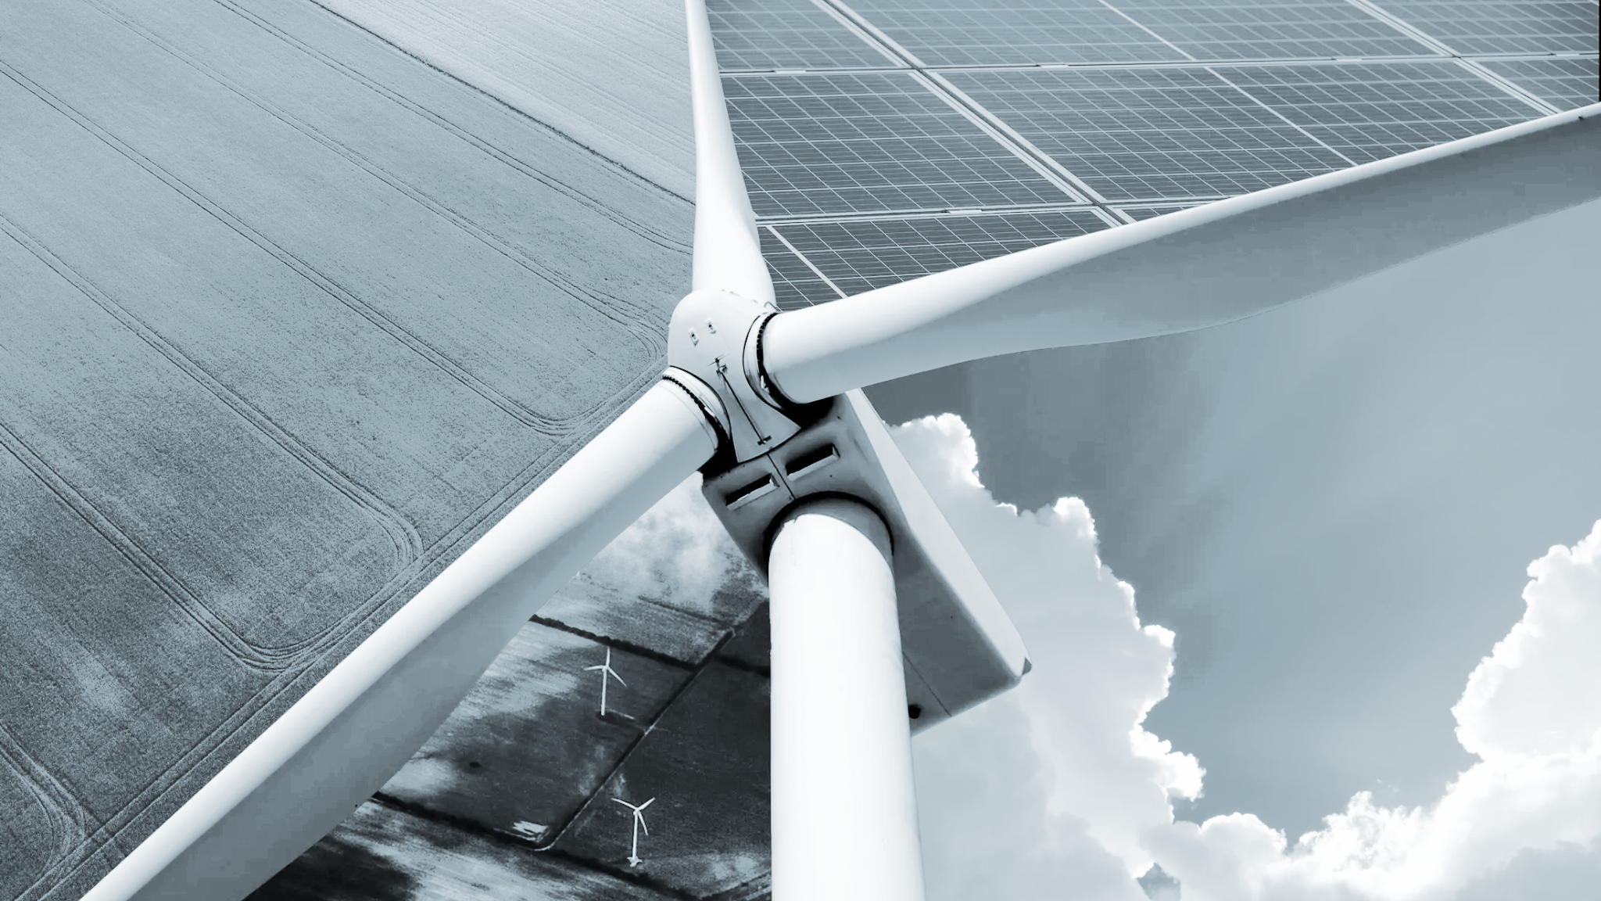


QR to be updated
Questions & Answers

Slide 32



Lunch time
Please come back by 13:15!
QR
To be finalized
Leave
questions
for us

Slide 33

Panel Discussion
Off-Site Solutions Deep-Dive: Unlocking DPPA
Tung Ho
(Moderator)
Vietnam Country Director
Allotrope Partners
Cong Nguyen
(Speaker)
Vietnam Clean Energy Manager
Allotrope Partners
Duc Nguyen
(Speaker)

Slide 34

Break
~20 minutes

Slide 35
Interactive Group Exercise
Roundtable Discussions on Procurement Lessons Sharing
(~45 minutes)
Please remain at your table.
Table facilitators will provide questions to discuss in an open dialogue format among the participants at your table.
Please share lessons from clean energy procurement processes that your company has conducted or challenges that have prevented clean energy action to date.

Slide 36
Interactive Exercise
DPPA Scenario Analysis (~60 minutes)
Please remain at your table.
Table facilitators will provide you with a resource packet containing case studies, description of roles, and key questions to facilitate the activity.
Collaborate with other participants to formulate a strategy, identify key terms and questions, and engage in a simulated DPPA negotiation.
Once the negotiation is complete, raise any remaining questions, or share challenges you experienced during the negotiation.

Slide 37
General Assumptions & Formula
Based on Decree 57/2025/ND-CP, the cost calculation parameters are assumed as follows:
Symbol | Unit | Assumed Value | Description
k |  | 1,026 | Adjustment coefficient
CDPPA_dv | VND/kWh | 360 | Power system service cost
Pcl | VND/kWh | 163,3 | Differential clearing fee
Kpp |  | 1,008 | Loss conversion coefficient at 110 kV voltage level
P1 | VND/kWh | 2,204 | Average retail electricity price
Cost Formulas
C_KH = C_EVN + C_CfD
=
=
(Pc − FMP) * Qc
Qkhhc * FMP * k * Kpp = C_DN
Qkhhc * C_dppa_dv = C_dppa
Qkhhc * Pcl = C_cl
(QKH − Qkhhc) * P1 = C_bl
+
+
+
Note: The plant sells all output to the spot market (receives FMP); the CfD only adjusts the price to Pc for the contracted volume Qc.

Slide 38
Scenario 1: The Base Case
Your manufacturing plant has a strict corporate target to reach 100% renewable energy consumption by 2030. To achieve this, your team wants to sign a DPPA via National Grid (Virtual DPPA) with a large solar developer.
Operational issue: Your factory doesn’t buy electricity directly from EVN. Instead, you pay your monthly electricity bill to the private Industrial Park Management Board, who buys bulk power from EVN and resells it to you through their internal grid.
Questions:
Under Decree 57, an Electricity Buyer must consume ≥200,000 kWh/month. If the IP lumps your factory into their master EVN meter, how do you accurately track and prove your specific energy use to qualify?
A standard Virtual PPA is a bilateral agreement (Between Buyer and Seller). However, since electricity delivery is controlled by the IP (Retailer), who actually needs to be at the negotiation table to make this work?
What happens if the IP demands a new, non-negotiable "infrastructure fee" to facilitate this DPPA setup? How does that impact your budget forecasting and management buy-in over a typical 15-to-20-year PPA Contract Term?

Slide 39



Scenario 1: The Base Case
Consumption = DPPA Volume (1)
Solar Plant 45MW
Difference Q_{KH} - Q_{KHhc} = 0 MWh
The customer doesn’t need additional electricity from EVN
Q_khhc = 5,000 MWh/month
5-Line Bill
1. Market electricity energy cost
C_{DN} = 5,000,000 kWh * 1,150 VND/kWh * 1.026 * 1.008 = 5,946,696,000 VND
2. System service fee
C_{DPPA} = 5,000,000 kWh * 360 VND/kWh = 1,800,000,000 VND
3. Difference clearing fee
C_{CL} = 5,000,000 kWh * 163.30 VND/kWh = 816,500,000 VND
4. Additional electricity purchase
C_{BL}= (QKH - Qkhhc)* P1 = 0 kWh * 2,204 VND/kWh = 0 VND
CfD
QC = 5,000 MWh/month
PC = 1,250 VND/kWh
FMP = 1,150 VND/kWh
Q_KH = 5,000 MWh/month
Large Customer
Total cost collected by EVN
C_{EVN} = 5,946,696,000 + 1,800,000,000 + 816,500,000 + 0 = 8,263,196,000 VND

Slide 40
Scenario 1: The Base Case
Consumption = DPPA Volume (2)
Solar Plant 45MW
5. CfD Contract Cost
C_{DN} = (PC - FMP) * QC = (1,250 - 1,150) VND/kWh * 5,000,000 kWh = 500,000,000 VND
Q_khhc = 5,000 MWh/month
Total Customer Cost (C_{KH} )
C_{KH} = C_{EVN} + C_{CfD} = 8,263,196,000 + 500,000,000 = 8,763,196,000 VND
CfD
QC = 5,000 MWh/month
PC = 1,250 VND/kWh
FMP = 1,150 VND/kWh
Power Plant Revenue
Revenue from the market
C_{TTD}: The plant generates the full 5,000 MWh (after loss ~5,040,000 kWh at the generator) C_{TTD}= (Qm * FMP) = 5,040,000 kWh * 1,150 VND/kWh = 5,796,000,000 VND
Revenue from CfD contract
C_{CfD} = QC * (PC - FMP) = 5,000,000 kWh * (1,250 - 1,150) = 500,000,000 VND
Total plant revenue is 5,796,000,000 + 500,000,000 = 6,296,000,000 VND
Q_KH = 5,000 MWh/month
Large Customer

Slide 41

Scenario 1: The Base Case
Consumption = DPPA Volume (3)
8,2 billion VND = 5,9 billion VND for market electricity energy
+ 1,8 billion VND service fee
+ 0.8 billion VND difference fee
+ 0 VND additional electricity purchase fee
Large Customer
EVN
0.5 billion VND according to the CfD contract
6.2 billion VND on the spot market
RE GENCO

Slide 42
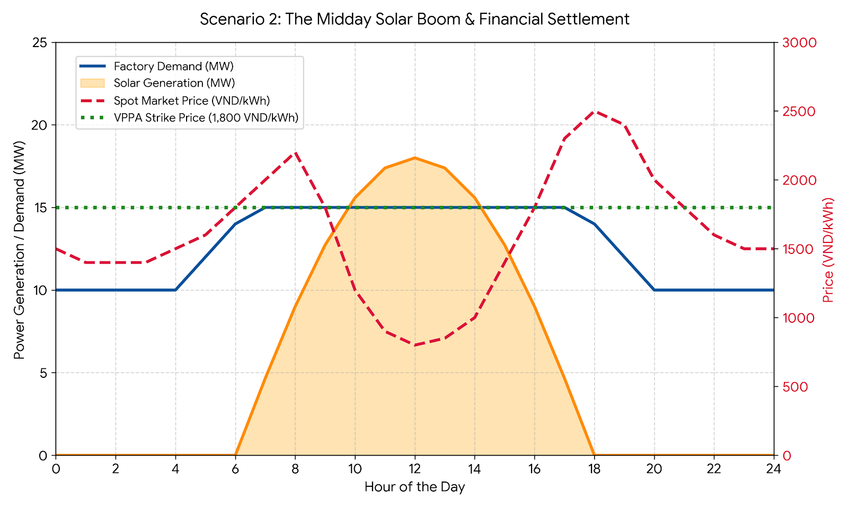
Scenario 2: The "Duck Curve" & Price Crashes
Your factory agrees to a Virtual DPPA (grid-connected) with a solar developer
Fixed "Strike Price" of 1,800 VND/kWh.
Factory continues to pay local utility for the physical electricity you consume to keep the machines running.
Factory & developer settle the difference between the Strike Price & the wholesale spot market floating price (FMP)
Sunny month: solar energy floods the national grid & the midday FMP drops to 800 VND/kWh.
Questions:
Who owes money to whom? Since you are essentially paying two bills, how does this complicate your factory's monthly operational costs?
Imagine a severe heat wave causes a power shortage, and the FMP spikes to 2,500 VND/kWh. How does the VPPA financially protect your factory's budget in this situation?
If EVN raises the DPPA fees next year, your overall energy costs go up. How do you communicate this ongoing regulatory risk to your CFO for DPPA approval?

Slide 43

Scenario 3
Actual Consumption Exceeds Contract Output (1)
Wind Plant 30MW
Difference Q_{KH} - Q_{KHhc} = 1000 MWh
The customer must purchase additional electricity from EVN
Actual Delivered Quantity = 8,000 MWh/month
1. Market electricity energy cost
C_{DN} = 8,000,000 kWh * 1,600 VND/kWh * 1.026 * 1.008 = 13,237,862,400 VND
2. System service fee
C_{DPPA} = 8,000,000 kWh * 360 VND/kWh = 2,880,000,000 VND
3. Difference clearing fee
C_{CL} = 8,000,000 kWh * 163.30 VND/kWh = 1,306,400,000 VND
4. Additional electricity purchase
C_{BL}= (QKH - Qkhhc)* P1 = 1,000,000 kWh * 2,204 VND/kWh = 2,204,000,000 VND
CfD
QC = 8,000 MWh/month
PC = 1,500 VND/kWh
FMP = 1,600 VND/kWh
Consumption = 9,000 MWh/month
Total cost collected by EVN
C_{EVN} = 13,237,862,400 + 2,880,000,000 + 1,306,400,000 + 2,204,000,000 = 19,628,262,400 VND
Large Customer

Slide 44
Scenario 3
Actual Consumption Exceeds Contract Output (2)
Wind Plant 30MW
5. CfD Contract Cost
C_{DN} = (PC - FMP) * QC = (1,500 - 1,600) VND/kWh * 8,000,000 kWh = -800,000,000 VND
Actual Delivered Quantity = 8,000 MWh/month
Total Customer Cost (C_{KH} )
C_{KH} = C_{EVN} + C_{CfD} = 19,628,262,400 + (-800,000,000) = 18,828,262,400 VND
CfD
QC = 8,000 MWh/month
PC = 1,500 VND/kWh
FMP = 1,600 VND/kWh
Power Plant Revenue
Revenue from the market
C_{TTD}: The plant generates the full 8,000 MWh (after loss ~8,064,000 kWh at the generator) C_{TTD}= 8,064,000 kWh * 1,600 VND/kWh = 12,902,400,000 VND
Revenue from CfD contract
C_{CfD} = QC * (PC - FMP) = 8,000,000 kWh * (1,500 - 1,600) = -800,000,000 VND
Total plant revenue is 12,902,400,000 + (-800,000,000) = 12,102,400,000 VND
Consumption = 9,000 MWh/month
Large Customer

Slide 45

Scenario 3
Actual Consumption Exceeds Contract Output (3)
19.628 billion VND = 13.238 billion for market electricity energy
+ 2.880 billion service fee
+ 1.306 billion difference fee
+ 2.204 billion additional electricity purchase fee
Large Customer
EVN
0.800 billion VND according to the CfD contract
12.902 billion VND on the spot market
RE GENCO

Slide 46
Scenario 4: One Large Customer buys Electricity from Multiple Power Plants (Different Contract Price for Each Plant) (1)
Wind Plant Y
Customer C
Solar Plant X
CfD
Pc,Y = 1,700 VND/kWh
CfD
Pc,X = 1,500 VND/kWh
Actual Delivered Quantity = 300,000 kWh
Consumption = 1,000,000 kWh
Actual Delivered Quantity = 600,000 kWh
The average EVN retail price is about 1,800 VND/kWh. Customer C receives 900,000 kWh of renewable electricity via DPPA (600k from X, 300k from Y) and must purchase an additional 100,000 kWh from EVN (regular grid electricity) to meet demand.
Assume the average electricity market price for that month is SMP = 1,600 VND/kWh (applied equally to both plants)
Then, comparing prices, plant X has Pc,X = 1,500 which is lower than SMP, plant Y has Pc,Y = 1,700 which is higher than SMP. This leads to plant X having to pay the difference to customer C, while customer C has to pay the difference to plant Y.

Slide 47
Scenario 4: One Large Customer buys Electricity from Multiple Power Plants (Different Contract Price for Each Plant) (2)
CALCULATIONS
Cost paid to EVN (for 900,000 kWh of renewables + 100,000 kWh additional):
Market electricity energy cost = 900,000 * 1,600 * 1.026 * 1.008 = 1,489,259,520 VND
DPPA service fee: 900,000 * 360 = 324,000,000 VND
Difference clearing fee: 900,000 * 163.30 = 146,970,000 VND
Additional electricity purchase: (1,000,000 - 900,000) * 1,800 = 180,000,000 VND (buy 100,000 kWh from EVN at ~1,800 VND/kWh)
→ Total cost collected by EVN: C_EVN = 1,489,259,520 + 324,000,000 + 146,970,000 + 180,000,000 = 2,140,229,520 VND
CfD contract cost (calculated separately for each plant):
For plant X: (P_cX - SMP) * Q_cX = (1,500 - 1,600) * 600,000 = -60,000,000 VND
For plant Y: (P_cY - SMP)* Q_cY = (1,700 - 1,600) * 300,000 = +30,000,000 VND
Total CfD cost (net): -60,000,000 + 30,000,000 = -30,000,000 VND.
Total cost of customer C: C_KH = C_EVN + C_CfD = 2,140,229,520 + (-30,000,000) = 2,110,229,520 VND

Slide 48
Scenario 4: One Large Customer buys Electricity from Multiple Power Plants (Different Contract Price for Each Plant) (3)
REVENUE CALCULATIONS
Revenue of plant X
Market revenue:
Plant X generates 600,000 kWh to C (~604,800 kWh at the generator with Kpp), receives 604,800 * 1,600 = 967,680,000 VND from EVN.
CfD payment: (1,500 - 1,600) * 600,000 = -60,000,000 VND (X pays C 60 million).
Total revenue of X: 967,680,000 + (-60,000,000) = 907,680,000 VND.
Revenue of plant Y
Market revenue:
Plant Y generates 300,000 kWh to C (~302,400 kWh at the generator), receives 302,400 * 1,600 = 483,840,000 VND from EVN.
CfD payment: (1,700 - 1,600) * 300,000 = +30,000,000 VND (Y receives an additional 30 million from C).
Total revenue of Y: 483,840,000 + 30,000,000 = 513,840,000 VND.

Slide 49
Scenario 4: One Large Customer buys Electricity from Multiple Power Plants (Different Contract Price for Each Plant) (4)
Solar Plant X
CfD contract:
60 million VND
967.68 million VND
Customer C
EVN
2.140 billion VND (900 MWh renewable electricity via EVN + 100 MWh regular electricity)
Wind Plant Y
CfD contract: 30 million VND
483.84 million VND

Slide 50
Scenario 5: One Power Plant sells to Multiple Customers
Market Price Fluctuates (1)
Customer A
Wind Plant (150MW)
Customer B
CfD
Pc,Y = 1,700 VND/kWh
CfD
Pc,X = 1,500 VND/kWh
Q_c,A = 18,000 MWh
Q_KHhc = 30,000 MWh
Q_c,B = 12,000 MWh
Total contract output allocated to customers exactly equals the plant's output
Difference Q_{KH} - Q_{KHhc} = 0 MWh
The customer doesn’t need additional electricity from EVN
But what happens when market price fluctuates?
Case 1: Market price is higher than contract price
Case 2: Market price is lower than contract price

Slide 51

Workshop Recap and Wrap Up

Slide 52
Key Takeaways Day 2
DPPA represents a critical step in scaling RE procurement in Vietnam. Large energy customers, customers lacking facility’s aligned with on-site requirements, and industrial park tenants can benefit from expanded access to RE procurement
First DPPA transactions are emerging in Vietnam. Early transactions are demonstrating the process and economic feasibility of VPPAs in Vietnam
Facility load profile is a key driver of cost performance. Day time load demand aligned with RE peak production can help to reduce costs under DPPA.
Cost ranges are critical for feasibility analysis: Market volatility, grid-loss adjustments, and load matching all materially affect DPPA costs - assess costs based on a range of downside and upside cost scenarios.

Slide 53
Recap and Wrap Up
Urgent need for action: Companies need to act quickly to implement clean energy solutions within this decade, as climate change is already significantly impacting Vietnam and the world.
Sustainability strengthens your business case: Emphasizing sustainability builds brand reputation, enhances client relationships, and increases positive public exposure. It also helps manage risks associated with energy management, regulatory compliance, and climate change.
Measuring emissions is critical: Understanding and quantifying GHG emissions across Scopes 1, 2, and 3 is crucial for effective sustainability management.
Regulatory requirements are emerging: In Vietnam, facilities with annual GHG emissions of 3,000 tons CO2 equivalent or more will be required to implement GHG emission reduction measures.
Data accuracy is key: Accurate data collection and reporting are essential for effective emissions tracking and reduction strategies.
Corporate demand for RE in Vietnam is growing: The C&I sector has the potential to send strong demand signals for accessible, expanded, cost-effective RE in Vietnam.
Challenges persist: While on-site clean energy procurement options are available today, off-site options are emerging, and scalability is limited by evolving policy, market, and technical challenges.
New opportunities are emerging: The introduction of the Direct Power Purchase Agreement mechanism may provide a significant opportunities for large energy buyers to advance off-site clean energy solutions, however, implementation is just beginning.

Slide 54
Recap and Wrap Up
01
Vietnam's DPPA is a game-changer
02
Pricing complexity is real
03
Load profile determines economics
The DPPA is now available but early-stage; implementation complexity demands careful planning and local expertise
Key negotiation variables: electricity retailer, RE source type, required capacity, contract duration, and project development status
Market volatility, grid-loss adjustments, and load matching all materially affect DPPA costs. Model the full formula — not just the strike price — before contracting.
Load timing significantly affects economics: operations with steady daytime demand see stronger DPPA outcomes than those with evening/night-heavy profiles
04
Corporate demand shapes the market
05
GHG measurement is the foundation
06
Act now — the window is open
C&I buyers collectively drive demand signals that influence RE accessibility, pricing trajectories, and supportive policy — early movers carry outsized influence.
Credible Scope 1, 2, and 3 measurement is a prerequisite for effective decarbonization action and meeting Vietnam's emerging regulatory requirements.
Regulatory requirements are tightening and market structures are maturing. Companies that engage early will gain first-mover advantage as DPPA scales.

Slide 55
Key Takeaways
Corporate demand for RE in Vietnam is growing: The C&I sector has the potential to send strong demand signals for accessible, expanded, cost-effective RE in Vietnam.
Start with your load and emissions data. Clean energy procurement decisions should begin with goal setting, facility-level electricity consumption, load profile, Scope 1–2 emissions, and any relevant Scope 3 or product carbon footprint requirements.
Match the solution to the facility constraint. On-site solar is the most available near-term option, but roof space, facility ownership, tenancy terms, and industrial park rules constraints will determine feasibility.
Treat BESS as a procurement design tool, not only a technology add-on. Battery storage can improve tariff resilience, increase daily renewable energy consumption, support peak shaving, and improve the commercial case for solar under evolving tariff structures.
Use RECs/EACs carefully and transparently. Unbundled RECs/EACs may support Scope 2 claims, but buyers should understand attribute ownership, additionality concerns, and the use cases between EACs and carbon offsets.
Monitor DPPA developments, but plan for uncertainty. DPPA may unlock larger off-site procurement, but buyers should account for evolving cost inputs, wheeling charges, settlement structures, and first-mover implementation challenges.
Challenges persist: While on-site clean energy procurement options are available today in Vietnam, scalability and further replication is limited by evolving policy, market, and technical challenges.

Slide 56
Key Takeaways - Day 1 Action Checklist
Confirm your clean energy objective and set actionable targets Identify your facility’s key decarbonization goals: Scope 2 reduction, buyer compliance, RE100 alignment, product carbon footprint reduction, or long-term price stability, and set actionable intermediate and long term targets to achieve these objectives.
Gather the right data Work with facility staff to collect 12 months of electricity bills, 30-minute or hourly load data if available, roof drawings, facility lease/ownership status, current EAC/REC contracts, and buyer sustainability requirements to assess site feasibility and constraints.
Screen near-term procurement options Assess rooftop solar+BESS where load, load shape, evening usage, or future tariff exposure align. Evaluate RECs/EACs as a complementary tool, not a substitute for direct procurement where feasible. Assess your site’s suitability for offsite procurements, and remain up to date on policy evolution.
Identify decision-makers and constraints Map who needs to approve the project: headquarters, procurement, finance, legal, factory management, landlord, industrial park operator, EVN/local utility, or sustainability/customer teams, and help decision makers understand the business case for RE procurement.

Slide 57
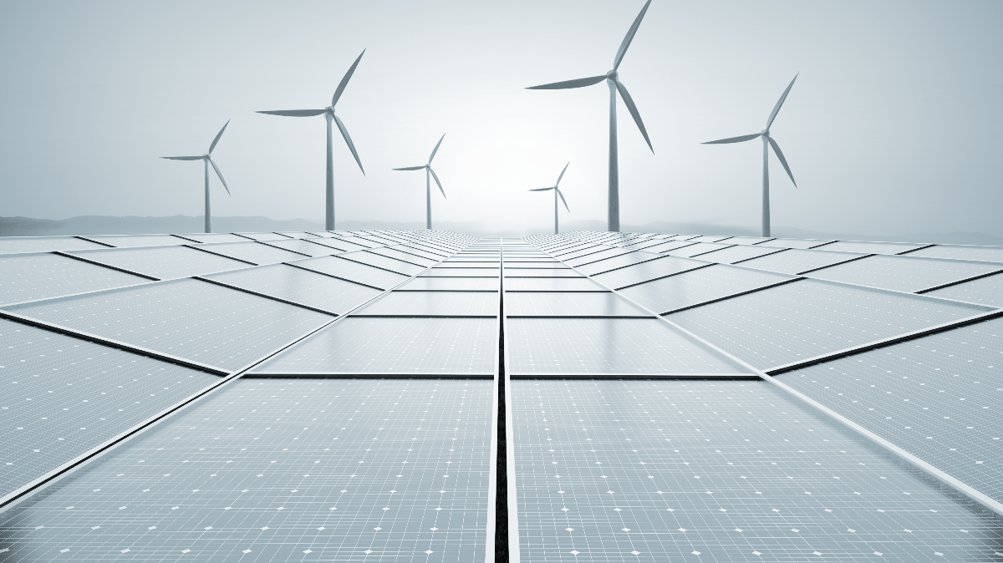

Before departing, please help fill out the Post-Event Survey.
Wrap Up & Survey (~5 minutes)
THANK YOU!
QR to be updated
Please contact us with any questions:
Tung Ho, tah@allotropepartners.com
info@allotropepartners.com

